Slide 1
Chapter 3: Introduction to SQL

Slide 2
Outline
Overview of The SQL Query Language
SQL Data Definition
Basic Query Structure of SQL Queries
Additional Basic Operations
Set Operations
Null Values
Aggregate Functions
Nested Subqueries
Modification of the Database
Notes:
1

Slide 3
History
IBM Sequel language developed as part of System R project at the IBM San Jose Research Laboratory
Renamed Structured Query Language (SQL)
ANSI and ISO standard SQL:
SQL-86
SQL-89
SQL-92
SQL:1999 (language name became Y2K compliant!)
SQL:2003
Commercial systems offer most, if not all, SQL-92 features, plus varying feature sets from later standards and special proprietary features.
Not all examples here may work on your particular system.

Slide 4
SQL Parts
DML -- provides the ability to query information from the database and to insert tuples into, delete tuples from, and modify tuples in the database.
integrity – the DDL includes commands for specifying integrity constraints. -> Primary key, Foreign Key, etc
View definition -- The DDL includes commands for defining views.
Transaction control –includes commands for specifying the beginning and ending of transactions.
Embedded SQL and dynamic SQL -- define how SQL statements can be embedded within general-purpose programming languages. [can use MySQL Commands in other programming languages to deal with SQL]
Authorization – includes commands for specifying access rights to relations and views.

Slide 5
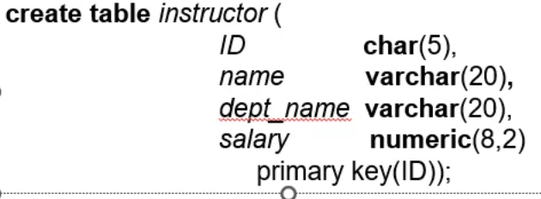
Data Definition Language
The SQL data-definition language (DDL) allows the specification of information about relations, including:
The schema for each relation.
The type of values associated with each attribute.
The Integrity constraints
The set of indices to be maintained for each relation.
Security and authorization information for each relation.
The physical storage structure of each relation on disk.

Slide 6
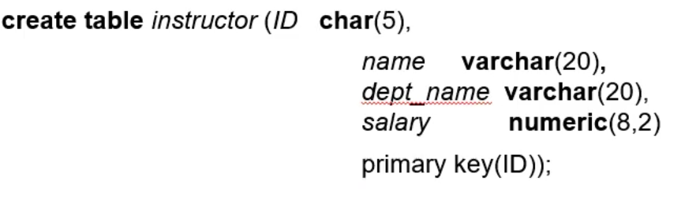
Domain Types in SQL
char(n). Fixed length character string, with user-specified length n.
varchar(n). Variable length character strings, with user-specified maximum length n.
int. Integer (a finite subset of the integers that is machine-dependent).
smallint. Small integer (a machine-dependent subset of the integer domain type).
numeric(p,d). Fixed point number, with user-specified precision of p digits, with d digits to the right of decimal point. (ex., numeric(3,1), allows 44.5 to be stores exactly, but not 444.5 or 0.32)
real, double precision. Floating point and double-precision floating point numbers, with machine-dependent precision.
float(n). Floating point number, with user-specified precision of at least n digits.
More are covered in Chapter 4.
Double is more accurate than Float. Then why do we have it? – It saves storage.

Slide 7
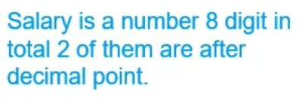
Create Table Construct
An SQL relation is defined using the create table command:
create table r
(A₁ D₁, A₂ D₂, ..., A_{n} D_{n}, (integrity-constraint₁), ..., (integrity-constraint_{k}))
r is the name of the relation
each A_{i} is an attribute name in the schema of relation r
D_{i} is the data type of values in the domain of attribute A_{i}
Example:
create table instructor ( ID char(5), name varchar(20), dept_name varchar(20), salary numeric(8,2)
primary key(ID));

Slide 8
Integrity Constraints in Create Table
Types of integrity constraints
primary key (A₁, ..., A_{n} )
foreign key (A_{m}, ..., A_{n} ) references r
not null
SQL prevents any update to the database that violates an integrity constraint.
Example:
create table instructor ( ID char(5), name varchar(20) not null, dept_name varchar(20), salary numeric(8,2), primary key (ID), foreign key (dept_name) references department);

Slide 9
And a Few More Relation Definitions
create table student ( ID varchar(5), name varchar(20) not null, dept_name varchar(20), tot_cred numeric(3,0), primary key (ID),
foreign key (dept_name) references department);
create table takes ( ID varchar(5), course_id varchar(8), sec_id varchar(8), semester varchar(6), year numeric(4,0), grade varchar(2),
primary key (ID, course_id, sec_id, semester, year) ,
foreign key (ID) references student, foreign key (course_id, sec_id, semester, year) references section);

Slide 10
And more still
create table course ( course_id varchar(8), title varchar(50), dept_name varchar(20), credits numeric(2,0),
primary key (course_id),
foreign key (dept_name) references department);

Slide 11
Updates to tables
Insert
insert into instructor values ('10211', 'Smith', 'Biology', 66000);
Delete
Remove all tuples from the student relation
delete from student
Drop Table
drop table r
Alter
alter table r add A D
where A is the name of the attribute to be added to relation r and D is the domain of A.
All exiting tuples in the relation are assigned null as the value for the new attribute.
alter table r drop A
where A is the name of an attribute of relation r
Dropping of attributes not supported by many databases.

Slide 12
Basic Query Structure
A typical SQL query has the form: select A₁, A₂, ..., A_{n} from r₁, r₂, ..., r_{m} where P
A_{i} represents an attribute
R_{i} represents a relation
P is a predicate.
The result of an SQL query is a relation.
Notes:
2

Slide 13
The select Clause
The select clause lists the attributes desired in the result of a query
corresponds to the projection operation of the relational algebra
Example: find the names of all instructors: select name from instructor
NOTE: SQL names are case insensitive (i.e., you may use upper- or lower-case letters.)
E.g., Name ≡ NAME ≡ name
Some people use upper case wherever we use bold font.
Notes:
3

Slide 14
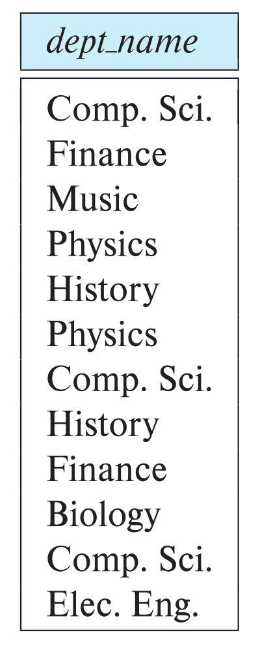
The select Clause (Cont.)
SQL allows duplicates in relations as well as in query results.
To force the elimination of duplicates, insert the keyword distinct after select.
Find the department names of all instructors, and remove duplicates
select distinct dept_name from instructor
The keyword all specifies that duplicates should not be removed.
select all dept_name from instructor
Notes:
4

Slide 15
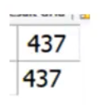
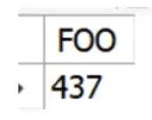

The select Clause (Cont.)
An asterisk in the select clause denotes “all attributes”
select * from instructor
An attribute can be a literal with no from clause
select '437'
Results is a table with one column and a single row with value “437”
Can give the column a name using:
select '437' as FOO
An attribute can be a literal with from clause
select 'A' from instructor
Result is a table with one column and N rows (number of tuples in the instructors table), each row with value “A”
Notes:
5

Slide 16
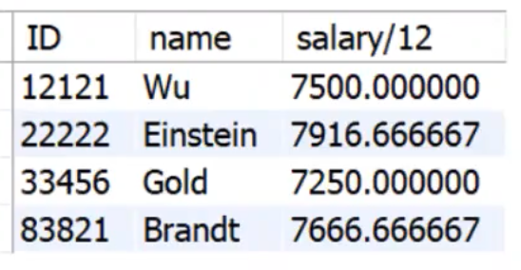
The select Clause (Cont.)
The select clause can contain arithmetic expressions involving the operation, +, –, ∗, and /, and operating on constants or attributes of tuples.
The query:
select ID, name, salary/12 from instructor
would return a relation that is the same as the instructor relation, except that the value of the attribute salary is divided by 12.
Can rename “salary/12” using the as clause:
select ID, name, salary/12 as monthly_salary
Salary/12 will be named as monthly_salary
Notes:
5

Slide 17
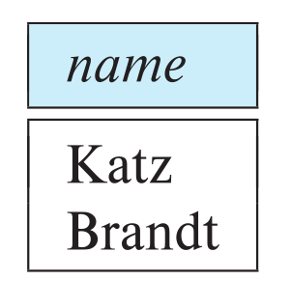
The where Clause
The where clause specifies conditions that the result must satisfy
Corresponds to the selection predicate of the relational algebra.
To find all instructors in Comp. Sci. dept
select name from instructor where dept_name = 'Comp. Sci.'
SQL allows the use of the logical connectives and, or, and not
The operands of the logical connectives can be expressions involving the comparison operators <, <=, >, >=, =, and <>.
Comparisons can be applied to results of arithmetic expressions
To find all instructors in Comp. Sci. dept with salary > 70000
select name from instructor where dept_name = 'Comp. Sci.' and salary > 70000
Notes:
6

Slide 18
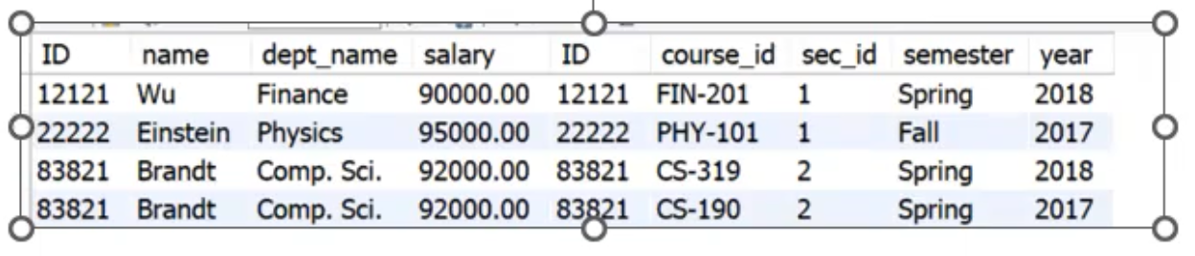
The from Clause
The from clause lists the relations involved in the query
Corresponds to the Cartesian product operation of the relational algebra.
Find the Cartesian product instructor X teaches
select ∗ from instructor, teaches
generates every possible instructor – teaches pair, with all attributes from both relations.
For common attributes (e.g., ID), the attributes in the resulting table are renamed using the relation name (e.g., instructor.ID)
Cartesian product not very useful directly, but useful combined with where-clause condition (selection operation in relational algebra).
Notes:
8

Slide 19
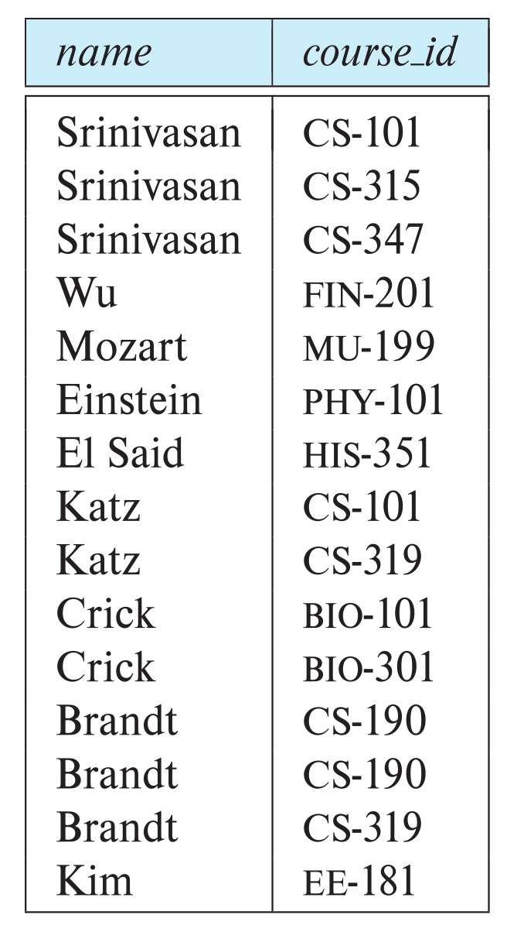
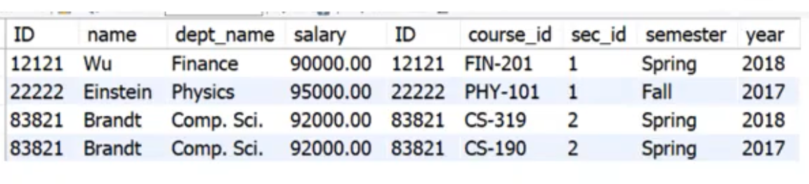
Examples
Find the names of all instructors who have taught some course and the course_id
select name, course_id from instructor , teaches where instructor.ID = teaches.ID
Find the names of all instructors in the Art department who have taught some course and the course_id
select name, course_id from instructor , teaches where instructor.ID = teaches.ID and instructor. dept_name = 'Art'
Notes:
9

Slide 20
The Rename Operation
The SQL allows renaming relations and attributes using the as clause:
old-name as new-name
Find the names of all instructors who have a higher salary than some instructor in 'Comp. Sci'.
select distinct T.name from instructor as T, instructor as S where T.salary > S.salary and S.dept_name = 'Comp. Sci.’ –copies of instructor relation.
Keyword as is optional and may be omitted instructor as T ≡ instructor T
Notes:
9

Slide 21
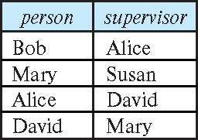
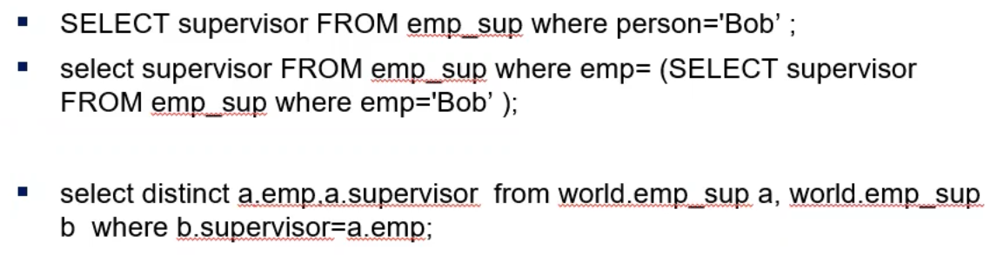
Self Join Example
Relation emp-super
Find the supervisor of “Bob”
Find the supervisor of the supervisor of “Bob”
Can you find ALL the supervisors (direct and indirect) of “Bob”?
Notes:
9

Slide 22
String Operations
SQL includes a string-matching operator for comparisons on character strings. The operator like uses patterns that are described using two special characters:
percent ( % ). The % character matches any substring.
underscore ( _ ). The _ character matches any character.
Find the names of all instructors whose name includes the substring “dar”.
select name from instructor where name like '%dar%'
Match the string “100%”
like '100 \%' escape '\'
in that above we use backslash (\) as the escape character.

Slide 23
String Operations (Cont.)
Patterns are case sensitive.
Pattern matching examples:
'Intro%' matches any string beginning with “Intro”.
'%Comp%' matches any string containing “Comp” as a substring.
'_ _ _' matches any string of exactly three characters.
'_ _ _ %' matches any string of at least three characters.
SQL supports a variety of string operations such as
concatenation (using “||”)
converting from upper to lower case (and vice versa)
finding string length, extracting substrings, etc.

Slide 24
Ordering the Display of Tuples
List in alphabetic order the names of all instructors
select distinct name from instructor order by name
We may specify desc for descending order or asc for ascending order, for each attribute; ascending order is the default.
Example: order by name desc
Can sort on multiple attributes
Example: order by dept_name, name

Slide 25
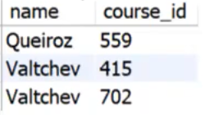
Where Clause Predicates
SQL includes a between comparison operator
Example: Find the names of all instructors with salary between $90,000 and $100,000 (that is, ≥ $90,000 and ≤ $100,000)
select name from instructor where salary between 90000 and 100000
Tuple comparison
Name and cource_id – instructors in Biology dept.
select name, course_id from instructor, teaches where (instructor.ID, dept_name) = (teaches.ID, 'Biology');
Notes:
7

Slide 26
Set Operations
Find courses that ran in Fall 2017 or in Spring 2018
(select course_id from section where sem = 'Fall' and year = 2017) union (select course_id from section where sem = 'Spring' and year = 2018)
Find courses that ran in Fall 2017 and in Spring 2018
(select course_id from section where sem = 'Fall' and year = 2017) intersect (select course_id from section where sem = 'Spring' and year = 2018)
Find courses that ran in Fall 2017 but not in Spring 2018
(select course_id from section where sem = 'Fall' and year = 2017) except (select course_id from section where sem = 'Spring' and year = 2018)

Slide 27
Set Operations (Cont.)
Set operations union, intersect, and except
Each of the above operations automatically eliminates duplicates
To retain all duplicates use the
union all,
intersect all
except all.

Slide 28
Null Values
It is possible for tuples to have a null value, denoted by null, for some of their attributes
null signifies an unknown value or that a value does not exist.
The result of any arithmetic expression involving null is null
Example: 5 + null returns null
The predicate is null can be used to check for null values.
Example: Find all instructors whose salary is null.
select name from instructor where salary is null
The predicate is not null succeeds if the value on which it is applied is not null.
Notes:
If it’s a primary key – null is not accepted.

Slide 29
Null Values (Cont.)
SQL treats as unknown the result of any comparison involving a null value (other than predicates is null and is not null).
Example: 5 < null or null <> null or null = null
The predicate in a where clause can involve Boolean operations (and, or, not); thus the definitions of the Boolean operations need to be extended to deal with the value unknown.
and : (true and unknown) = unknown, (false and unknown) = false, (unknown and unknown) = unknown
or: (unknown or true) = true, (unknown or false) = unknown (unknown or unknown) = unknown
Result of where clause predicate is treated as false if it evaluates to unknown
Notes:
select true and null;
Select false and null;

Slide 30
Aggregate Functions
These functions operate on the multiset of values of a column of a relation, and return a value
avg: average value min: minimum value max: maximum value sum: sum of values count: number of values

Slide 31
Aggregate Functions Examples
Find the average salary of instructors in the Computer Science department
select avg (salary) from instructor where dept_name= 'Comp. Sci.';
Find the total number of instructors who teach a course in the Spring 2018 semester
select count (distinct ID) from teaches where semester = 'Spring' and year = 2018;
Find the number of tuples in the course relation
select count (*) from course;

Slide 32
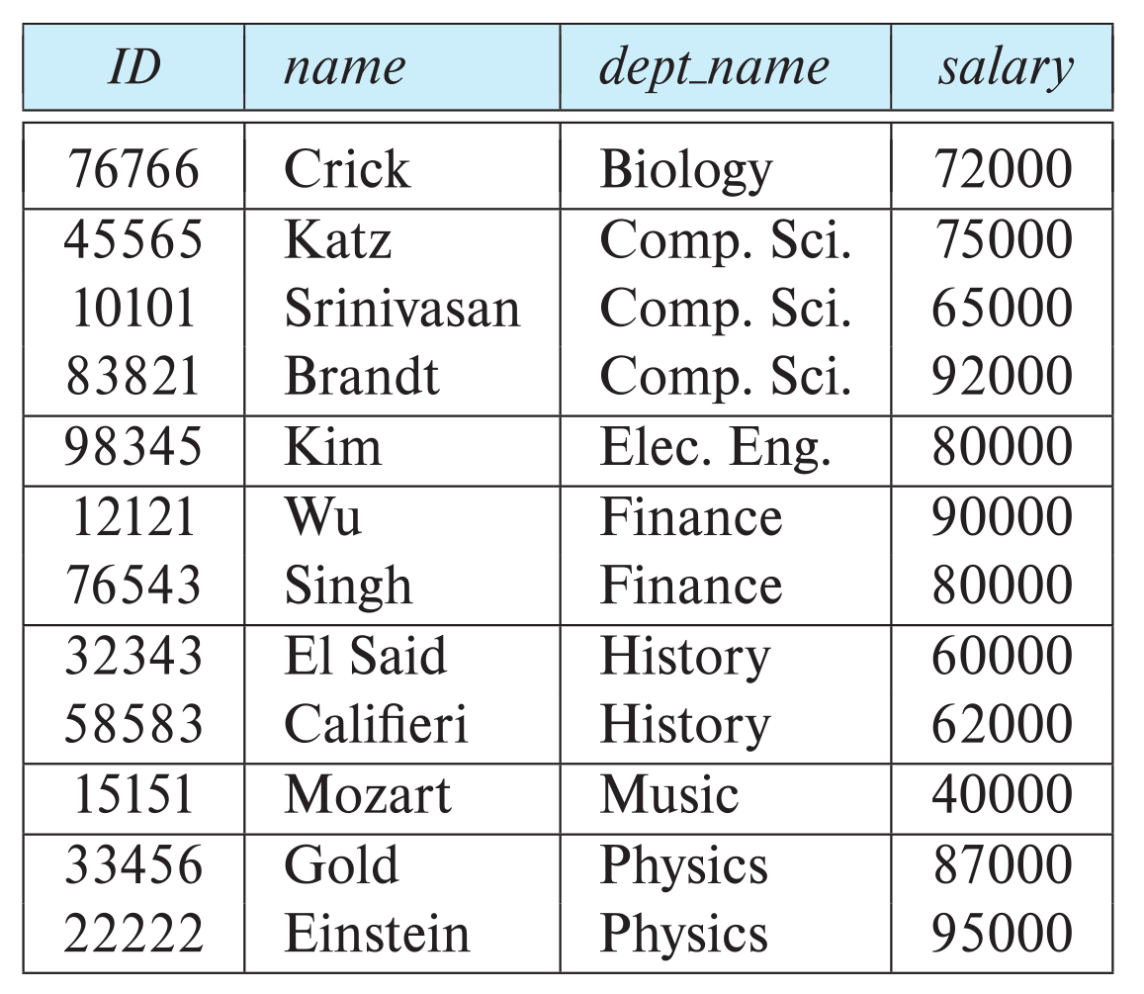
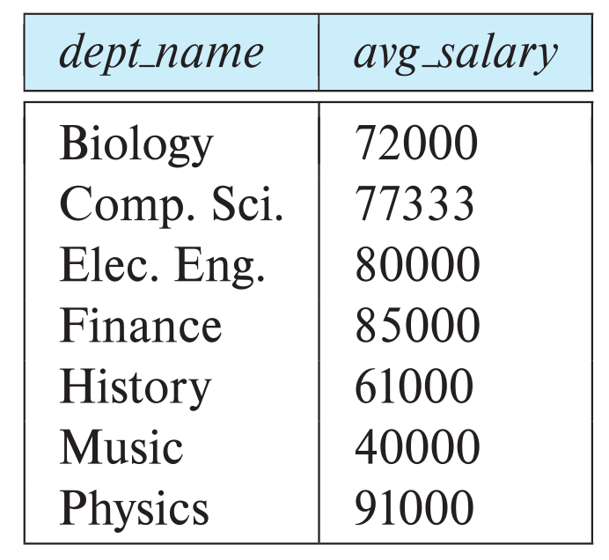
Aggregate Functions – Group By
Find the average salary of instructors in each department
select dept_name, avg (salary) as avg_salary from instructor group by dept_name;
Notes:
This is incorrect – because the ID of instructors can be multiple.

Slide 33
Aggregation (Cont.)
Attributes in select clause outside of aggregate functions must appear in group by list
/* erroneous query */ select dept_name, ID, avg (salary) from instructor group by dept_name;

Slide 34
Aggregate Functions – Having Clause
Find the names and average salaries of all departments whose average salary is greater than 42000
Note: predicates in the having clause are applied after the formation of groups whereas predicates in the where clause are applied before forming groups
select dept_name, avg (salary) as avg_salary
from instructor
group by dept_name
having avg (salary) > 42000;

Slide 35
Nested Subqueries
SQL provides a mechanism for the nesting of subqueries. A subquery is a select-from-where expression that is nested within another query.
The nesting can be done in the following SQL query select A₁, A₂, ..., A_{n} from r₁, r₂, ..., r_{m} where P
as follows:
From clause: r_{i} can be replaced by any valid subquery
Where clause: P can be replaced with an expression of the form:
B <operation> (subquery)
B is an attribute and <operation> to be defined later.
Select clause:
A_{i} can be replaced be a subquery that generates a single value.

Slide 36
Set Membership

Slide 37
Set Membership
Find courses offered in Fall 2017 and in Spring 2018
Find courses offered in Fall 2017 but not in Spring 2018
select distinct course_id
from section
where semester = 'Fall' and year= 2017 and course_id in (select course_id
from section
where semester = 'Spring' and year= 2018);
select distinct course_id
from section
where semester = 'Fall' and year= 2017 and course_id not in (select course_id
from section
where semester = 'Spring' and year= 2018);

Slide 38
Set Membership (Cont.)
Name all instructors whose name is neither “Mozart” nor Einstein”
select distinct name
from instructor
where name not in ('Mozart', 'Einstein')
Find the total number of (distinct) students who have taken course sections taught by the instructor with ID 10101
Note: Above query can be written in a much simpler manner. The formulation above is simply to illustrate SQL features
select count (distinct ID)
from takes
where (course_id, sec_id, semester, year) in (select course_id, sec_id, semester, year
from teaches
where teaches.ID= 10101);

Slide 39
Set Comparison

Slide 40
Set Comparison – “some” Clause
Find names of instructors with salary greater than that of some (at least one) instructor in the Biology department.
Same query using > some clause
select distinct T.name
from instructor as T, instructor as S
where T.salary > S.salary and S.dept name = 'Biology';
select name
from instructor
where salary > some (select salary
from instructor
where dept name = 'Biology');

Slide 41
Definition of “some” Clause
F <comp> some r ⇔ ∃ t ∈ r such that (F <comp> t ) Where <comp> can be: <, ≤, >, =, ≠
0
(5 < some
5
) = true
(read: 5 < some tuple in the relation)
6
0
(5 < some
5
) = false
0
(5 = some
) = true
5
0
(5 ≠ some
5
) = true (since 0 ≠ 5)
(= some) ≡ in
However, (≠ some) ≡ not in

Slide 42
Set Comparison – “all” Clause
Find the names of all instructors whose salary is greater than the salary of all instructors in the Biology department.
select name
from instructor
where salary > all (select salary
from instructor
where dept name = 'Biology');

Slide 43
Definition of “all” Clause
F <comp> all r ⇔ ∀ t ∈ r (F <comp> t)
0
(5 < all
5
) = false
6
6
(5 < all
) = true
10
4
(5 = all
) = false
5
4
(5 ≠ all
) = true (since 5 ≠ 4 and 5 ≠ 6)
6
(≠ all) ≡ not in
However, (= all) ≡ in

Slide 44
Test for Empty Relations
The exists construct returns the value true if the argument subquery is nonempty.
exists r ⇔ r ≠ Ø
not exists r ⇔ r = Ø

Slide 45
Use of “exists” Clause
Yet another way of specifying the query “Find all courses taught in both the Fall 2017 semester and in the Spring 2018 semester”
select course_id from section as S where semester = 'Fall' and year = 2017 and exists (select * from section as T where semester = 'Spring' and year= 2018 and S.course_id = T.course_id);
Correlation name – variable S in the outer query
Correlated subquery – the inner query

Slide 46
Use of “not exists” Clause
Find all students who have taken all courses offered in the Biology department.
Note that X – Y = Ø ⇔ X ⊆ Y
Note: Cannot write this query using = all and its variants
select distinct S.ID, S.name
from student as S
where not exists ( (select course_id
from course
where dept_name = 'Biology')
except
(select T.course_id
from takes as T
where S.ID = T.ID));
First nested query lists all courses offered in Biology
Second nested query lists all courses a particular student took

Slide 47
Test for Absence of Duplicate Tuples
The unique construct tests whether a subquery has any duplicate tuples in its result.
The unique construct evaluates to “true” if a given subquery contains no duplicates .
Find all courses that were offered at most once in 2017
select T.course_id from course as T where unique ( select R.course_id from section as R where T.course_id= R.course_id and R.year = 2017);

Slide 48
Subqueries in the From Clause

Slide 49
Subqueries in the From Clause
SQL allows a subquery expression to be used in the from clause
Find the average instructors’ salaries of those departments where the average salary is greater than $42,000.”
select dept_name, avg_salary from ( select dept_name, avg (salary) as avg_salary from instructor group by dept_name) where avg_salary > 42000;
Note that we do not need to use the having clause
Another way to write above query
select dept_name, avg_salary from ( select dept_name, avg (salary) from instructor group by dept_name)
as dept_avg (dept_name, avg_salary)
where avg_salary > 42000;

Slide 50
With Clause
The with clause provides a way of defining a temporary relation whose definition is available only to the query in which the with clause occurs.
Find all departments with the maximum budget with max_budget (value) as (select max(budget) from department) select department.name from department, max_budget where department.budget = max_budget.value;
Notes:
Sometimes we are not given access to some tables. In that case, we can create a temporary table using with clause.

Slide 51
Complex Queries using With Clause
Find all departments where the total salary is greater than the average of the total salary at all departments
with dept _total (dept_name, value) as
(select dept_name, sum(salary)
from instructor
group by dept_name),
dept_total_avg(value) as
(select avg(value)
from dept_total)
select dept_name
from dept_total, dept_total_avg
where dept_total.value > dept_total_avg.value;

Slide 52
Scalar Subquery
Scalar subquery is one which is used where a single value is expected
List all departments along with the number of instructors in each department
select dept_name, ( select count(*) from instructor where department.dept_name = instructor.dept_name) as num_instructors from department;
Runtime error if subquery returns more than one result tuple

Slide 53
Modification of the Database
Deletion of tuples from a given relation.
Insertion of new tuples into a given relation
Updating of values in some tuples in a given relation

Slide 54
Deletion
Delete all instructors
delete from instructor
Delete all instructors from the Finance department delete from instructor where dept_name= 'Finance’;
Delete all tuples in the instructor relation for those instructors associated with a department located in the Watson building.
delete from instructor where dept name in (select dept name from department where building = 'Watson');

Slide 55
Deletion (Cont.)
Delete all instructors whose salary is less than the average salary of instructors
Problem: as we delete tuples from instructor, the average salary changes
Solution used in SQL:
First, compute avg (salary) and find all tuples to delete
Next, delete all tuples found above (without recomputing avg or retesting the tuples)
delete from instructor
where salary < (select avg (salary)
from instructor);

Slide 56
Insertion
Add a new tuple to course
insert into course values ('CS-437', 'Database Systems', 'Comp. Sci.', 4);
or equivalently
insert into course (course_id, title, dept_name, credits) values ('CS-437', 'Database Systems', 'Comp. Sci.', 4);
Add a new tuple to student with tot_creds set to null
insert into student values ('3003', 'Green', 'Finance', null);

Slide 57
Insertion (Cont.)
Make each student in the Music department who has earned more than 144 credit hours an instructor in the Music department with a salary of $18,000.
insert into instructor select ID, name, dept_name, 18000 from student where dept_name = 'Music' and total_cred > 144;
The select from where statement is evaluated fully before any of its results are inserted into the relation.
Otherwise queries like
insert into table1 select * from table1
would cause problem

Slide 58
Updates
Give a 5% salary raise to all instructors
update instructor set salary = salary * 1.05
Give a 5% salary raise to those instructors who earn less than 70000 update instructor set salary = salary * 1.05 where salary < 70000;
Give a 5% salary raise to instructors whose salary is less than average
update instructor set salary = salary * 1.05 where salary < (select avg (salary) from instructor);

Slide 59
Updates (Cont.)
Increase salaries of instructors whose salary is over $100,000 by 3%, and all others by a 5%
Write two update statements:
update instructor set salary = salary * 1.03 where salary > 100000; update instructor set salary = salary * 1.05 where salary <= 100000;
The order is important
Can be done better using the case statement (next slide)

Slide 60
Case Statement for Conditional Updates
Same query as before but with case statement
update instructor set salary = case when salary <= 100000 then salary * 1.05 else salary * 1.03 end

Slide 61
Updates with Scalar Subqueries
Recompute and update tot_creds value for all students
update student S set tot_cred = (select sum(credits) from takes, course where takes.course_id = course.course_id and S.ID= takes.ID.and takes.grade <> 'F' and takes.grade is not null);
Sets tot_creds to null for students who have not taken any course
Instead of sum(credits), use:
case when sum(credits) is not null then sum(credits) else 0 end

Slide 62
End of Chapter 3

